Slide 1


Microservices
Architecture
Presenter Name: Mehul Vaghela
Date

Slide 2
AGENDA
01 | Monolith & SOA Architecture | 01
02 | Problems with Monolith & SOA | 02
03 | Microservices Architecture | 03
04 | Problems solved by Microservices | 04
05 | Design Microservice Architecture | 05
06 | When Not to use Microservices | 06

Slide 3

Monolith & SOA

Slide 4
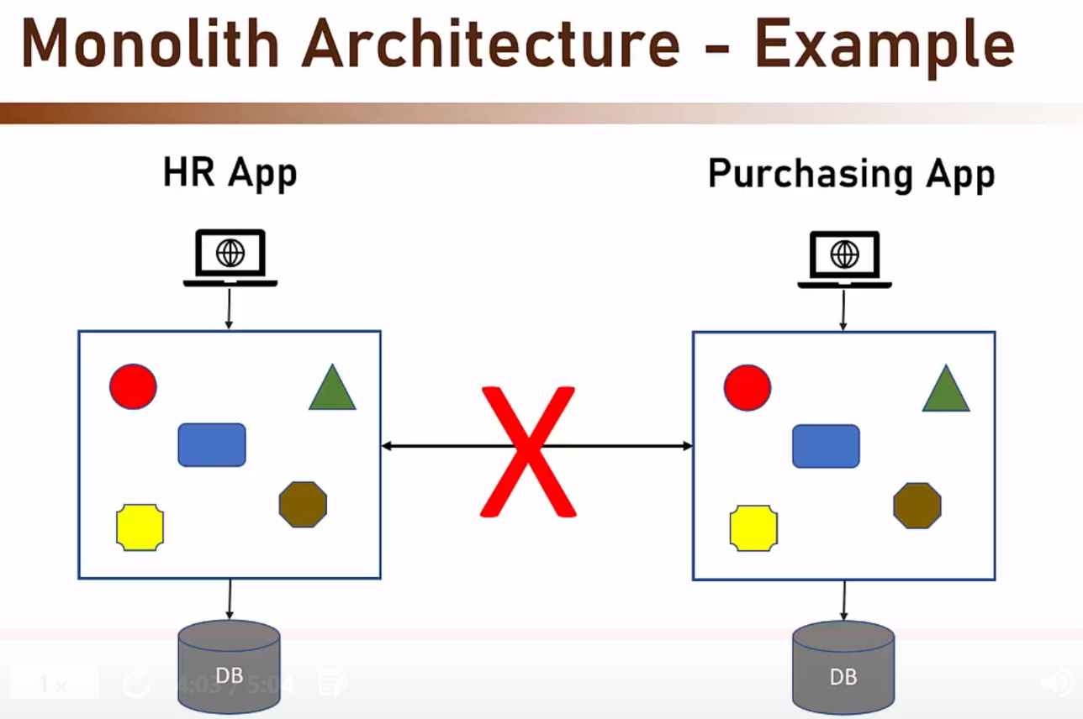
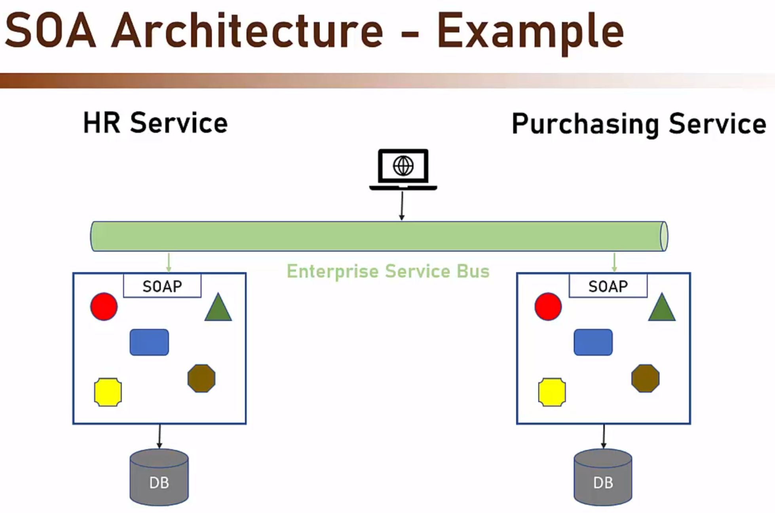
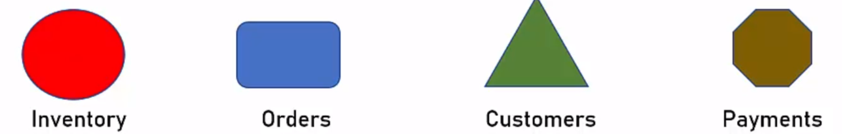
Monolith & SOA Architecture
Monolith :
The original parent architecture
All software components are executed in a single process
No sharing, No distribution of any kind
Strong coupling between all classes
Usually implemented as Silo (Stand alone)
SOA :
First coined in 1998
Apps are services exposing functionality to the outside world
Services expose metadata to declare their functionality
Usually implemented using SOAP & WSDL (metadata written in these file)
Usually implemented with ESB (Enterprise Service Bus)
Services communicate using ESB

Slide 5
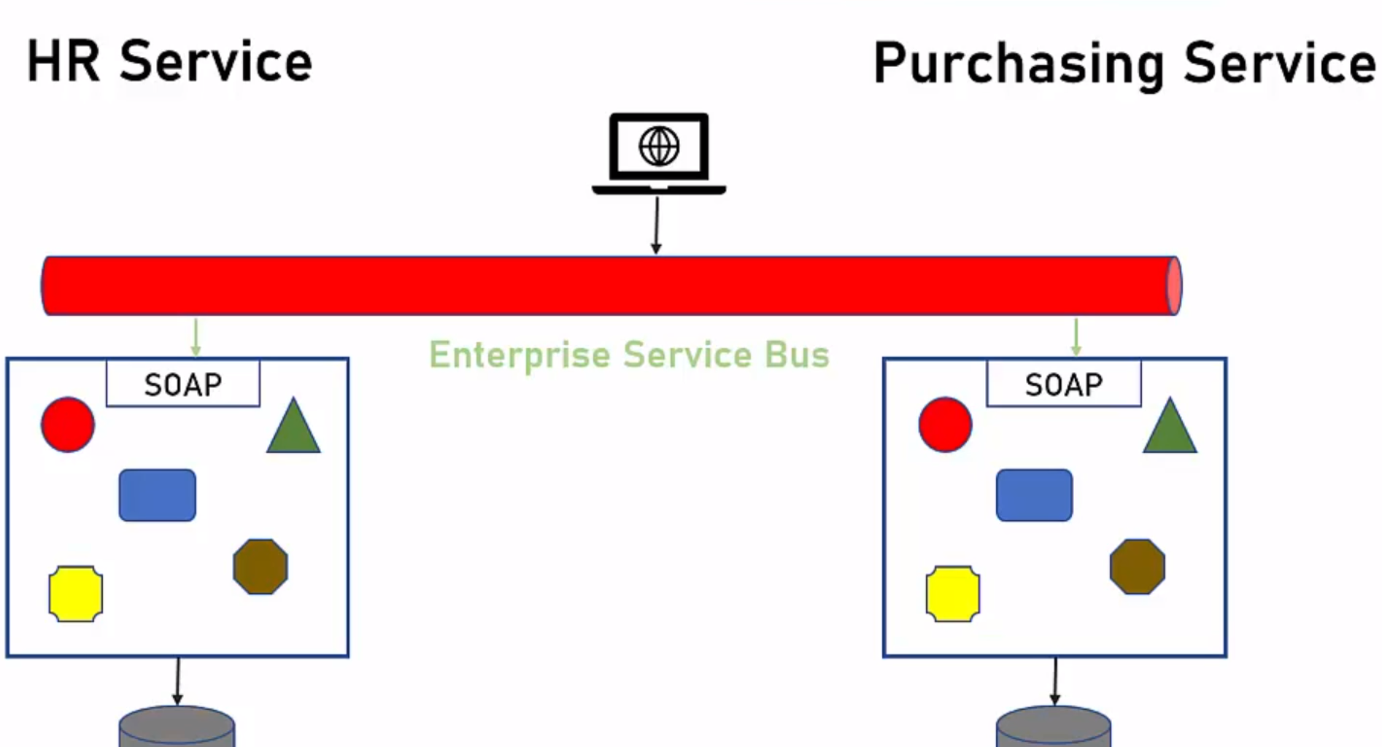
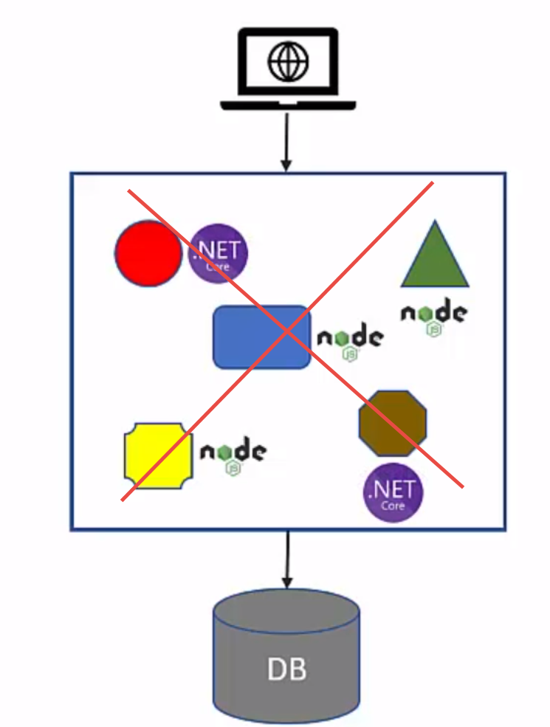
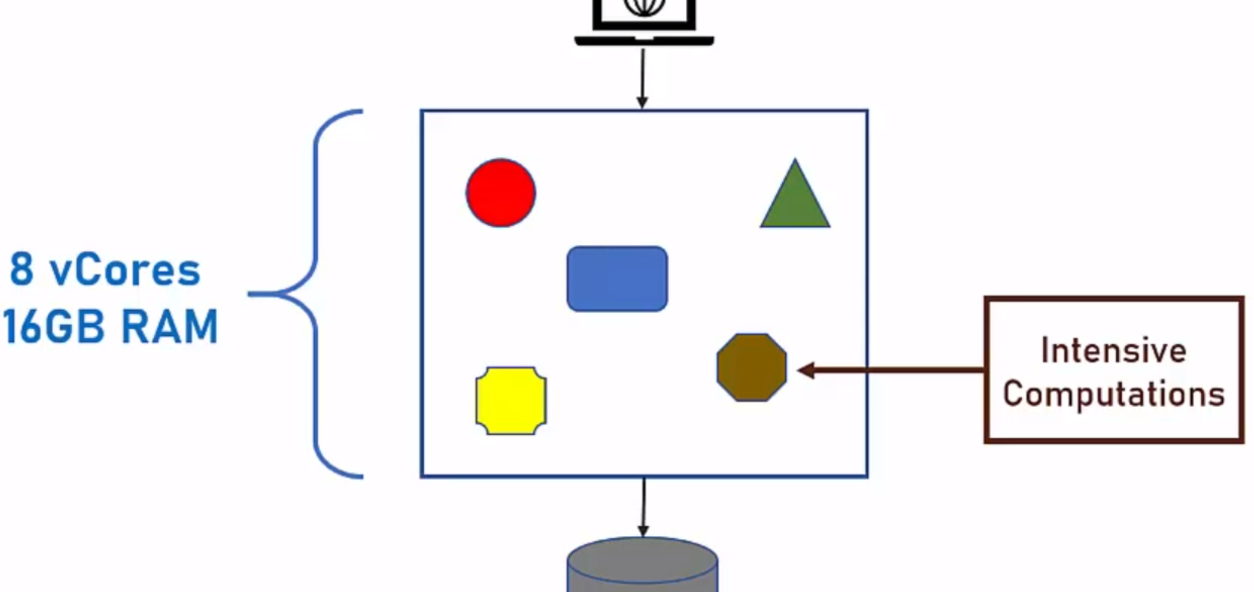
Problems with Monolith & SOA
Monolith :
Single Technology Platform
New deployment always for the whole app
Even when updating only one component - the whole code base is deployed
Forces rigorous testing for every deployment
Forces long development cycles
Compute resources (CPU & RAM) are divided across all components
If a specific component needs more resources - no way to do that
SOA :
With SOA, the ESB is one of the main Components (only communication Channel) e.g. routing, validation, authentication
Expensive (e.g., Oracle & IBM providers)
No Tools are existed for support below,
Quick & short development cycle were needed
Quick testing & deployment
No time saving was achieved & Forces long development cycles

Slide 6
Microservices

Slide 7
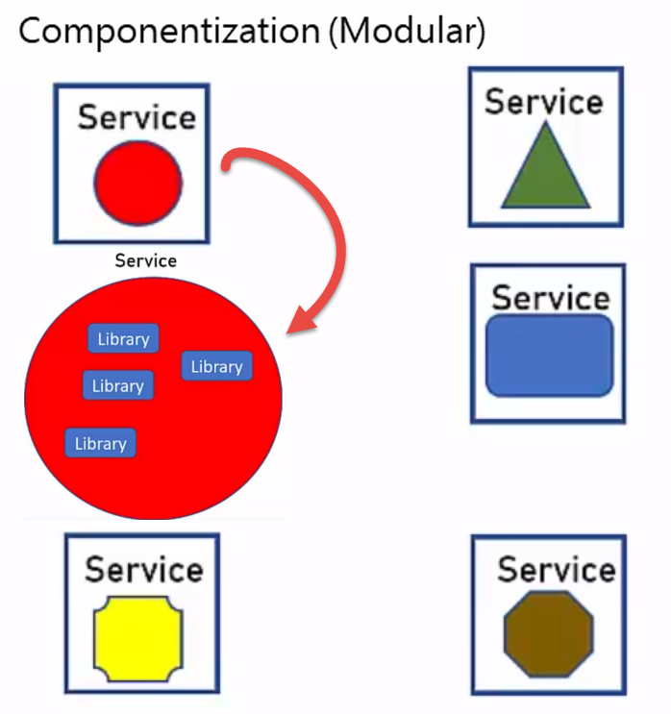
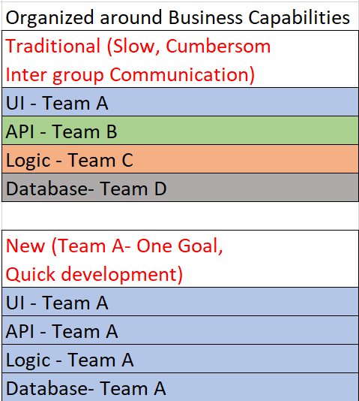
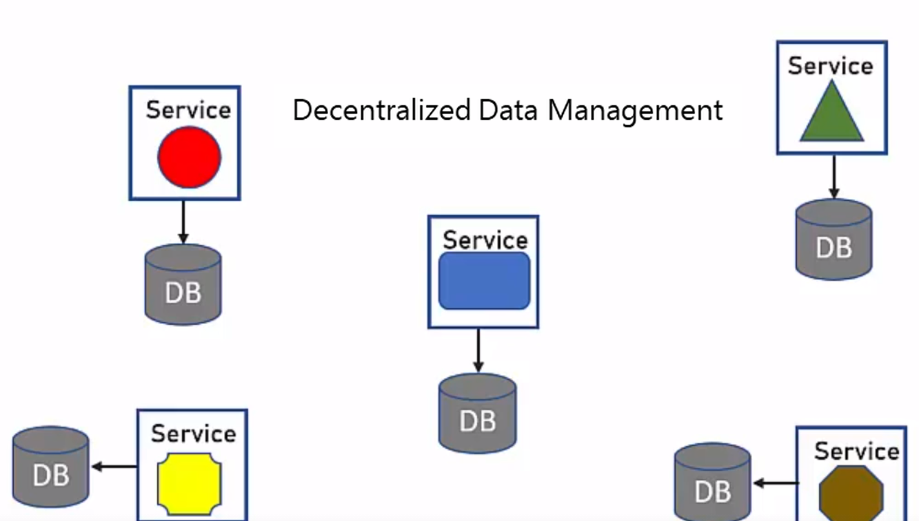
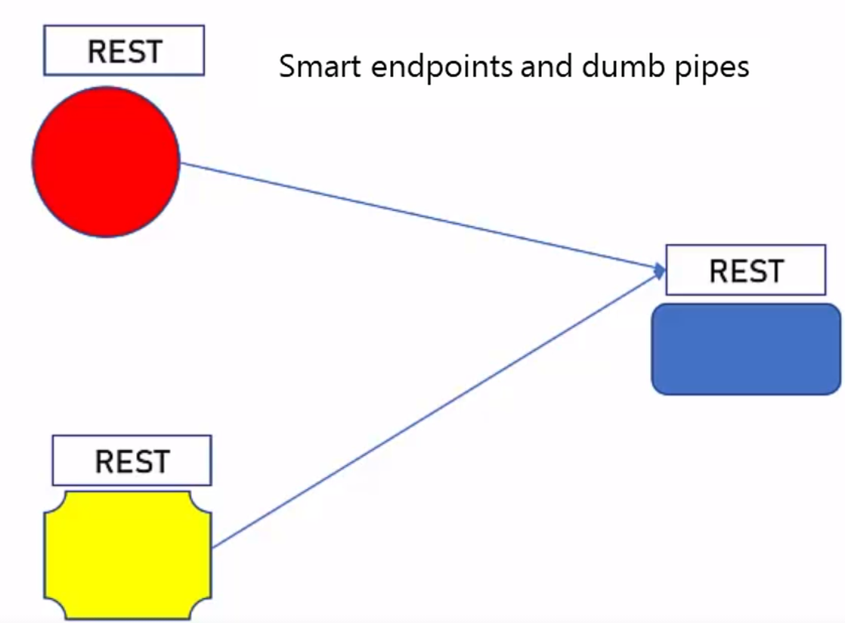
Microservice Architecture
Designing software applications as suites of independently deployable services.
Characteristics of a Microservice Architecture :
Componentization (Modular) via Services
Organized around Business Capabilities
Products not Projects (“You build it, Your run it”, Agile Methodology)
Smart endpoints and dumb pipes (http protocol)
Decentralized Governance (Team makes its own decision for platform, database technology etc.)
Decentralized Data Management (Not always)
Infrastructure Automation ( e.g., DevOps, GitLab, Jenkin)
Design for failure (e.g., Network traffic, one service down
to resolve Monitor using Kubernetes)
Evolutionary Design ( Monolith to Microservice upgrade)

Slide 8
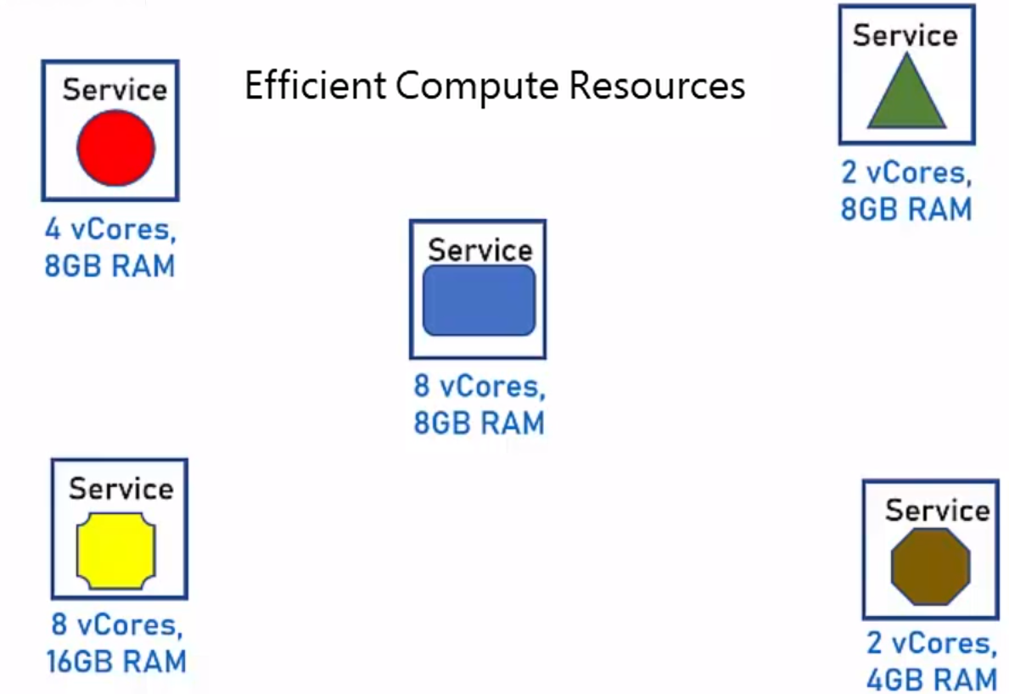
Problem Solved by Microservices
Single Technology Platform (By Componentization (Modular) via Services)
Inflexible Deployment (By Decentralized Governance & Data Management)
Efficient Compute Resources (By Componentization)
Large and Complex (By Componentization, Organized Team)
In SOA, Complicated and Expensive ESB (By Smart Endpoint, Dumb pipes)
In SOA, Lack of Tooling (By Infrastructure Automation )

Slide 9
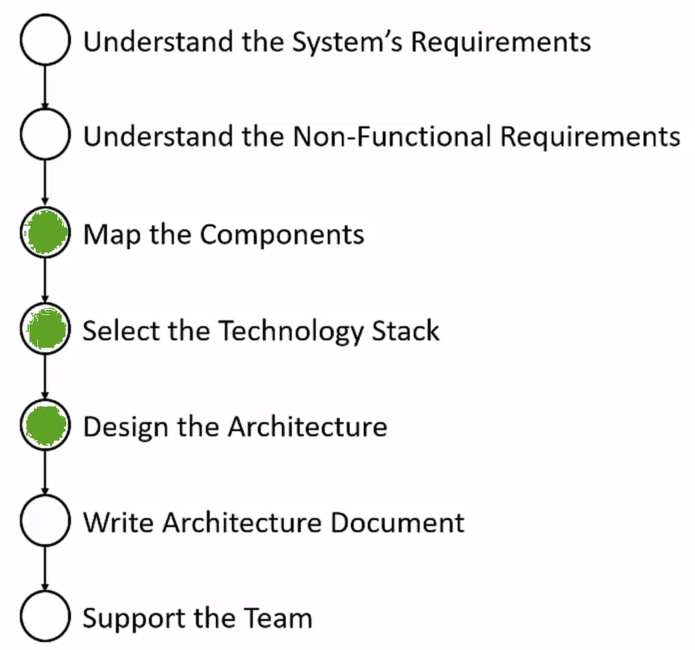
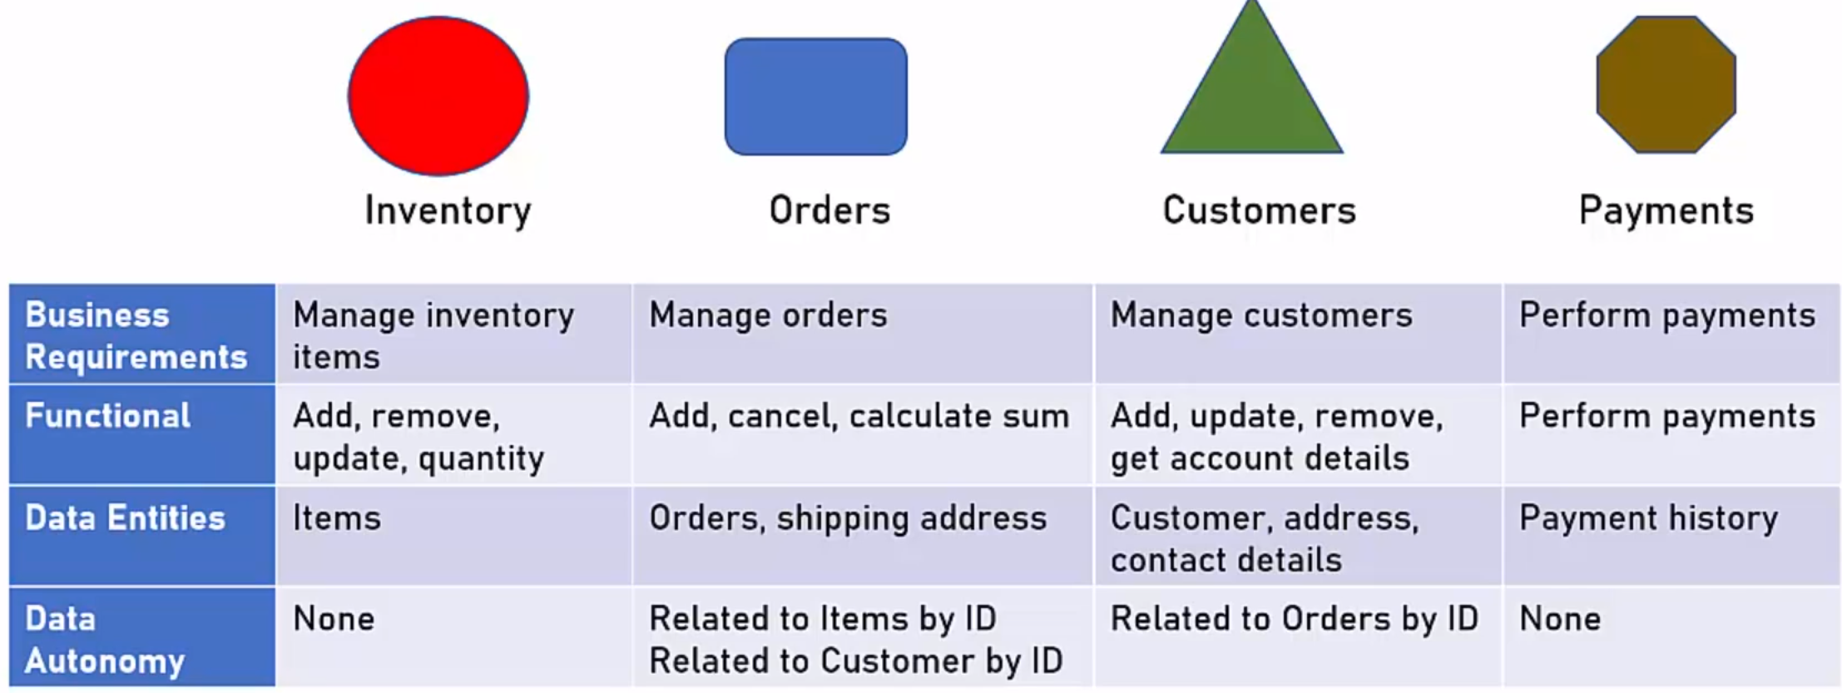
Design Microservice Architecture
Design should be methodical.
Don’t rush into development, “Plan more, code less”.
Map the Components
Define the various components of the system based on:
(1) Business requirements
(e.g., Order Management : Add, Remove, Update)
(2) Functional autonomy (Functions of same module)
(e.g., OM: Retrieve the orders made in last week)
(3) Data entities (e.g., Orders, Items)
(4) Data autonomy
Remember: Components = Services

Slide 10

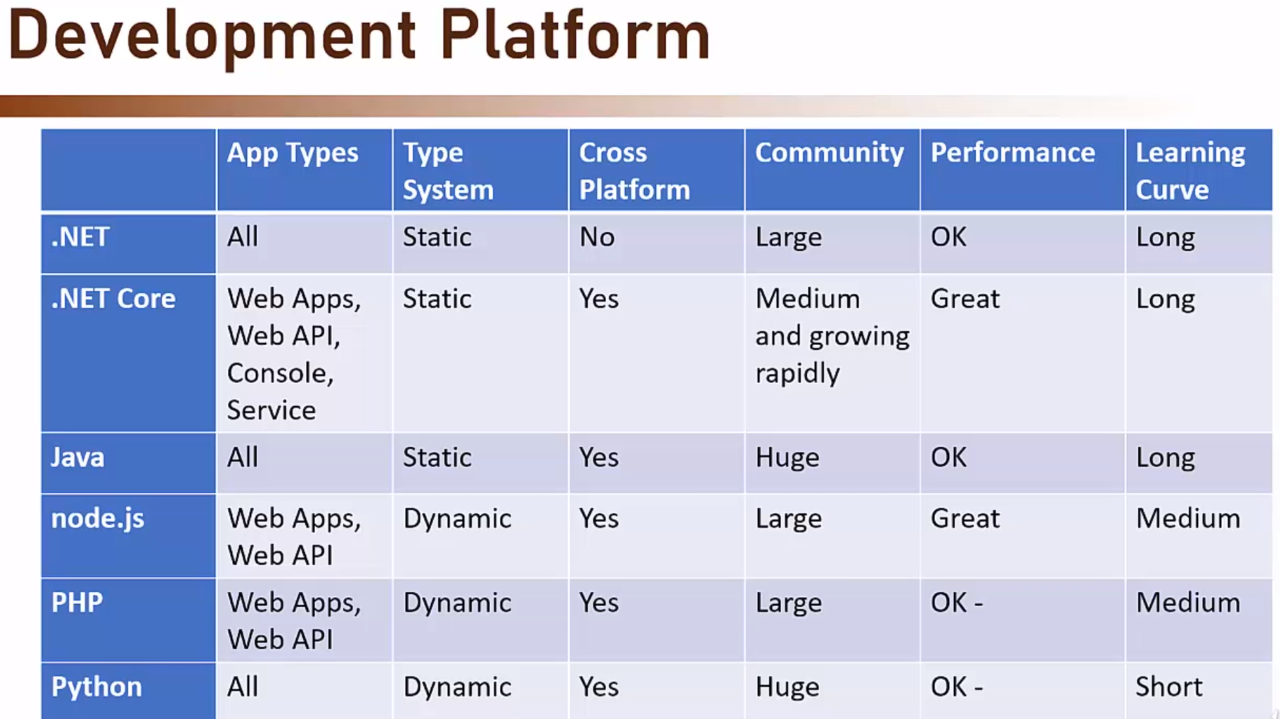
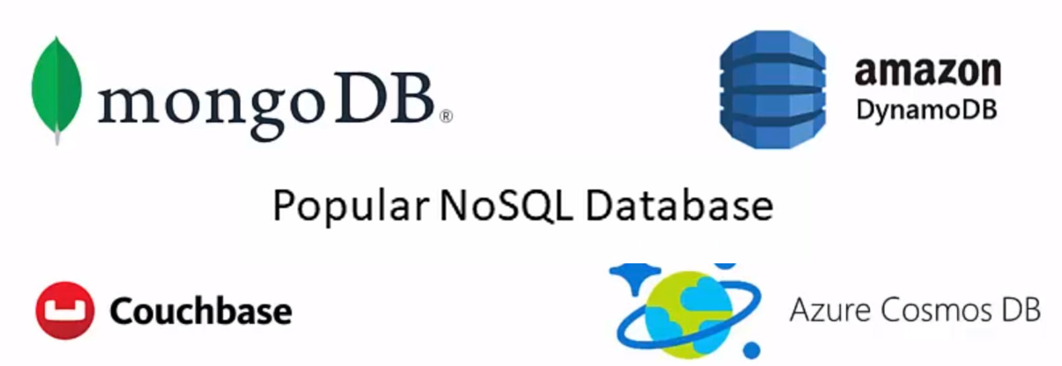

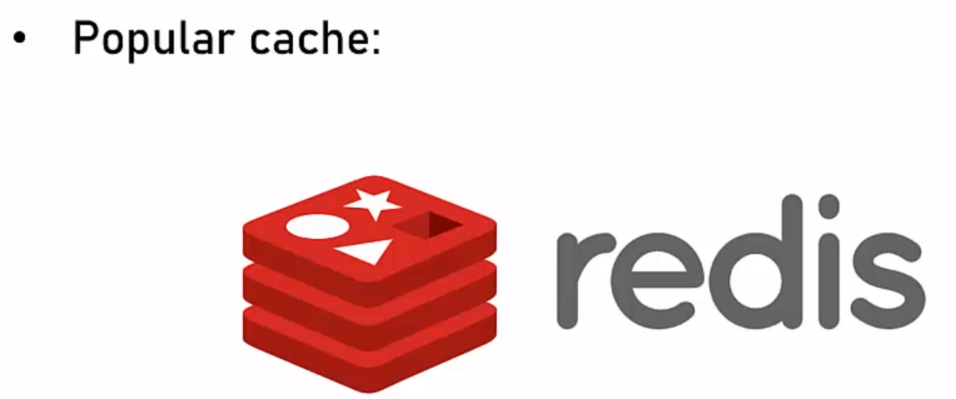
Technology Stack
Data Store
Relational Database (Structured)
NoSQL Database (Semis Structured)
e.g., usually stored in JSON format
Cache (In Memory)
Object Store (Unstructured)
e.g., Documents, Photos, Files
Decentralized Governance allows selecting different
technology stack for each service
Make it concrete decision based on hard evidence.

Slide 11
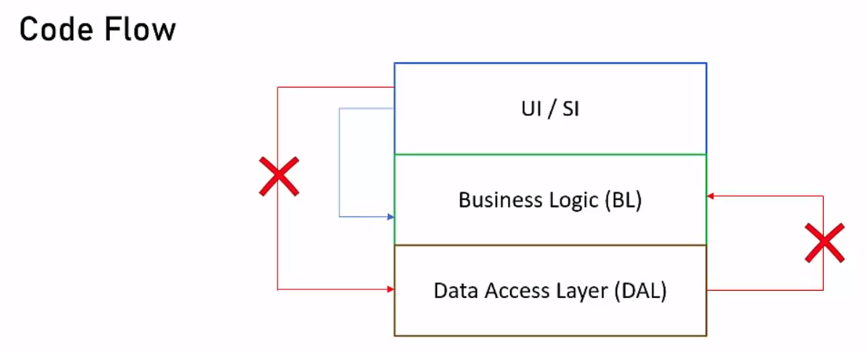
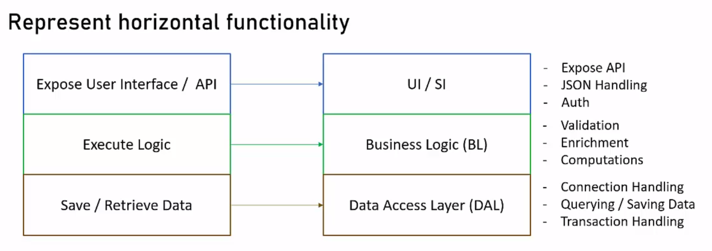
Design Microservices
Based on the Layer paradigm
Layer represent horizontal functionality
Code Flow between layers

Slide 12

When Not to Use Microservices
Small Systems (Low complexity use monolith)
Intermingled Functionality or Data
(When there is no way to separate logic or data)
Performance Sensitive Systems-
(Sometime Microservice have network hops overhead)
Quick & Dirty Systems– If small, quick system and need it Now then don’t go with Microservices
No Planned Updates – e.g. embedded systems where hardware is not available for quick testing

Slide 13

Westborough - USA
Gandhingar - India
1900 West Park Drive, Suite 280 Westborough, MA 01581
Ph.: +(888) 510-2552
eMail: sales@infosensedigital.ai
Plot No. 135, Nr. Yash Plaza, Raysan, Gandhinagar, Gujarat - 382007
Ph.: +91(0)79 23213024
eMail: sales@infosensedigital.ai

